Slide 1
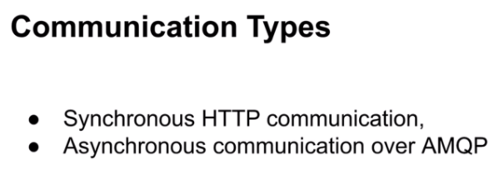
Communication Between Microservices

Slide 2
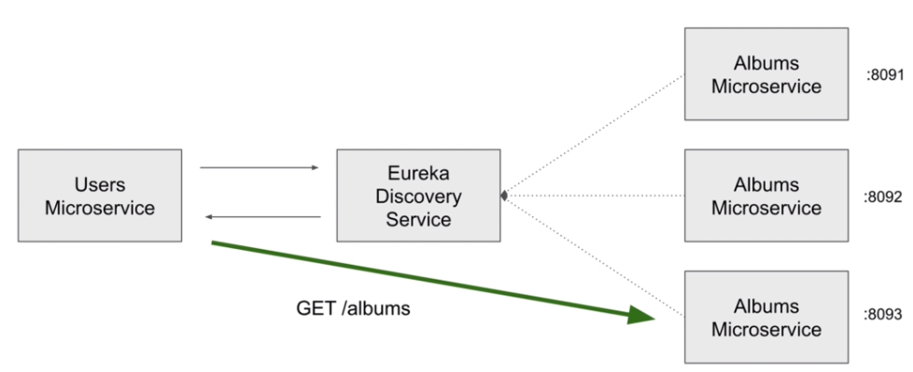

Slide 3
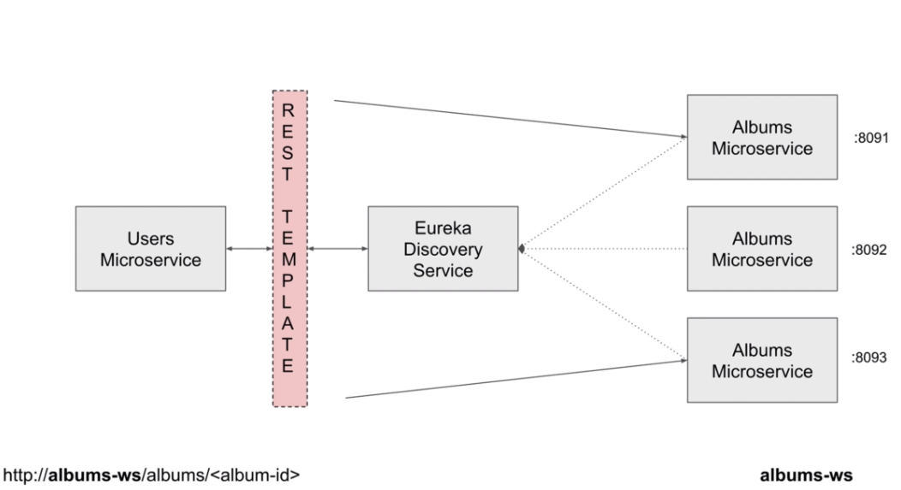

Slide 4
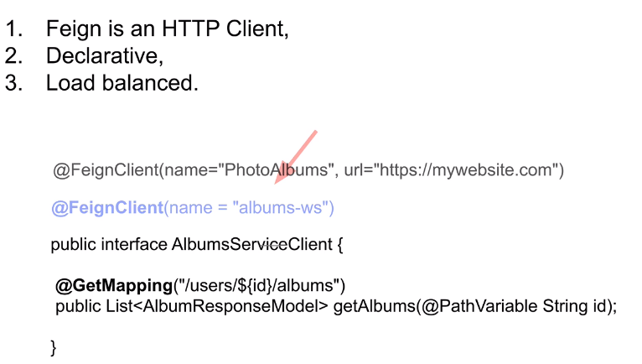
Feign Web Service Client

Slide 5
Enable Feign in Spring Boot Project
<dependency>
<groupId>org.springframework.cloud</groupId>
<artifactId>spring-cloud-starter-openfeign</artifactId>
</dependency>
@SpringBootApplication
@EnableDiscoveryClient
@EnableFeignClients
public class AccountsApplication {
public static void main(String[] args) {
SpringApplication.run(AccountsApplication.class, args);
}

